Slide 1
Software Development (Coding)

Slide 2
General Rule of Best Coding Practice
Program Should be Simple
  Try to Stay away from nested “If … Then … Else …” statements.
  Readability.
Program Should be Well Documented
  Main functions provided
  Revision History
Program Should be Modularized
  Component based design and development
  Well documented interface (API)
  Component should be test thoroughly

Slide 3
Source Code Control
Facilitate Team Work.
Manage multiple builds and releases
Check-in
Builds
Code
Depositor
Releases
Check-out
Developers
Release Manager

Slide 4
Code Reviews
Improve Code Quality
Cross Training
Cohesive Coding Style
Promote Consistent Naming Conventions

Slide 5
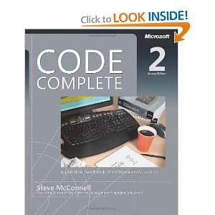
Recommended Reference Book
Code Complete: A Practical Handbook of Software Construction [Paperback] by Steve McConnell

